Slide 1

ESFP Project
___________________________________________________________________________________________________________
ContactManagmentSystem
Presented by
Shubham Patel
21162171024
CS-25
___________________________________________________________________________________________________________

Slide 2
Primary Concepts Used
___________________________________________________________________________________________________________
Header Files
File Handling
Choice Based Statements
If-Else Statements
Switch Case Statements
___________________________________________________________________________________________________________

Slide 3
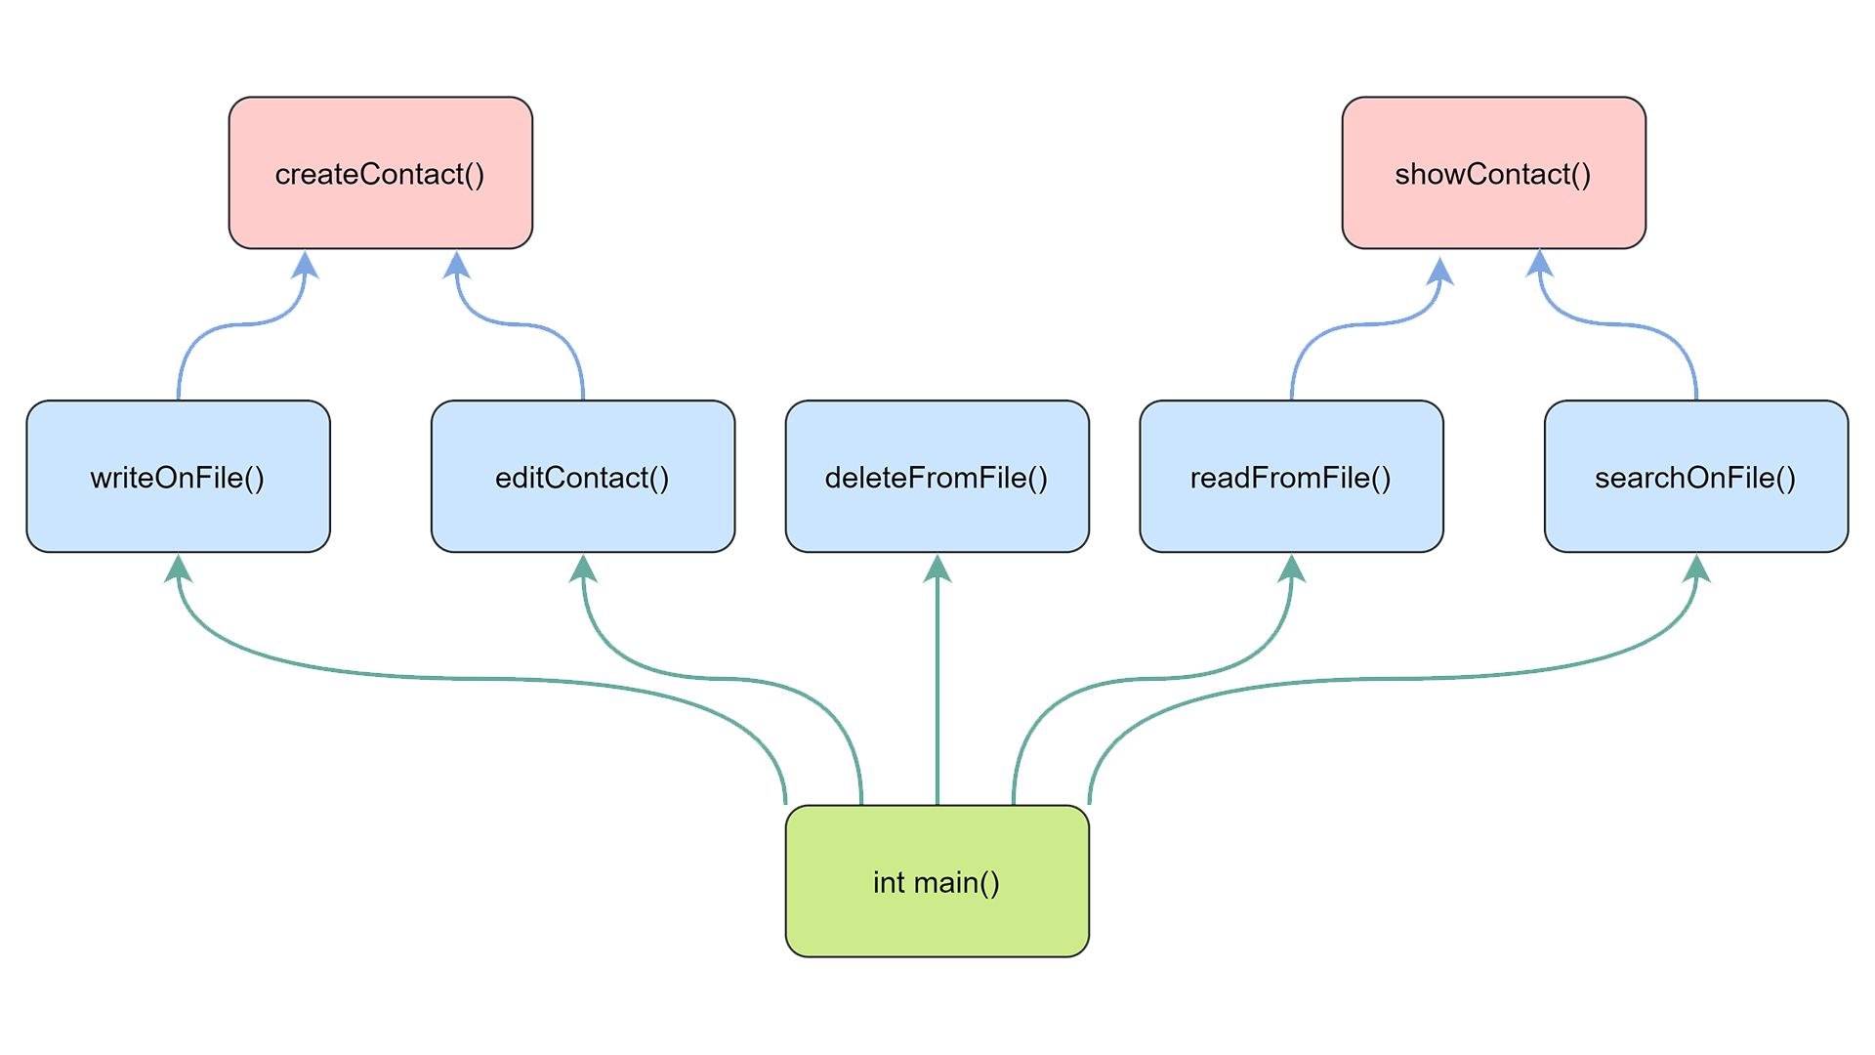

Slide 4
Header Files
___________________________________________________________________________________________________________
<iostream>: It is used as a stream of Input and Output using cin and cout.
<fstream>: Defines several classes that support iostreams operations on
sequences stored in external files..
___________________________________________________________________________________________________________

Slide 5
File Handling
___________________________________________________________________________________________________________
Ofstream: Used for creating a file and write data on files.
Ifstream: Used for reading the data from files.
Fstream: Used for both read and write data from files.
___________________________________________________________________________________________________________

Slide 6
File Handling
___________________________________________________________________________________________________________
open(): It is used to create a file.
close(): It is used to close an existing file.
read(): It is used to read data from file.
seekp():It moves the put pointer (output) to a
specified location.
write() :It is used to write data into file.
___________________________________________________________________________________________________________

Slide 7
File Handling
___________________________________________________________________________________________________________
ios::out: This mode is opened for writing a file.
ios::in: This mode is opened for reading a file.
ios::app : This mode is opened for appending
data to end-of-file.
ios::binary: The file is opened in binary mode.
___________________________________________________________________________________________________________

Slide 8
Choice Based Statements
___________________________________________________________________________________________________________
Many If-Else statements are used for every possible scenario.
Switch Case is used to store the data.
___________________________________________________________________________________________________________

Slide 9
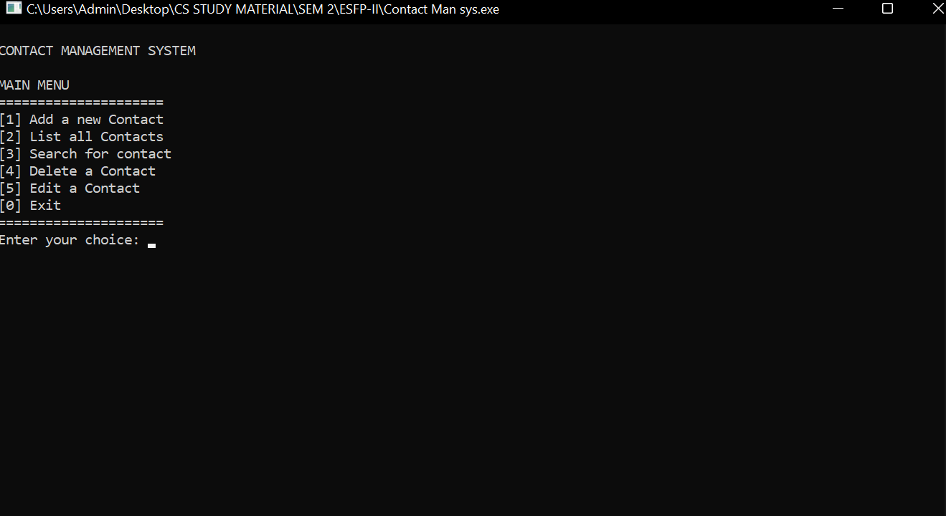
Screenshots
___________________________________________________________________________________________________________
___________________________________________________________________________________________________________

Slide 10
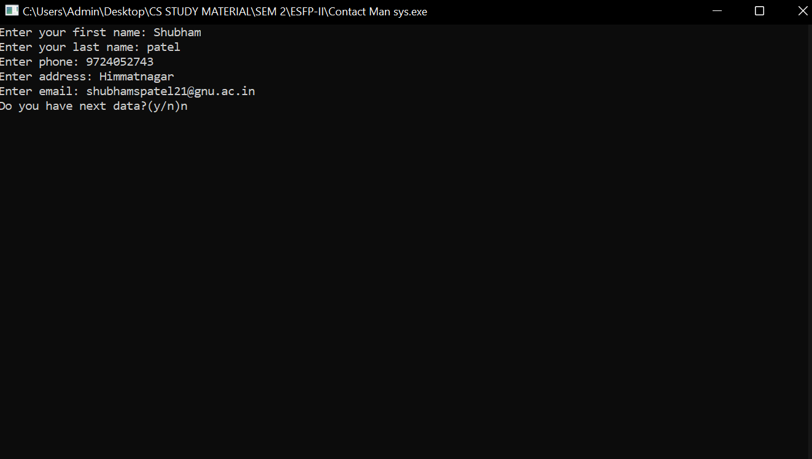
Screenshots
___________________________________________________________________________________________________________
___________________________________________________________________________________________________________

Slide 11
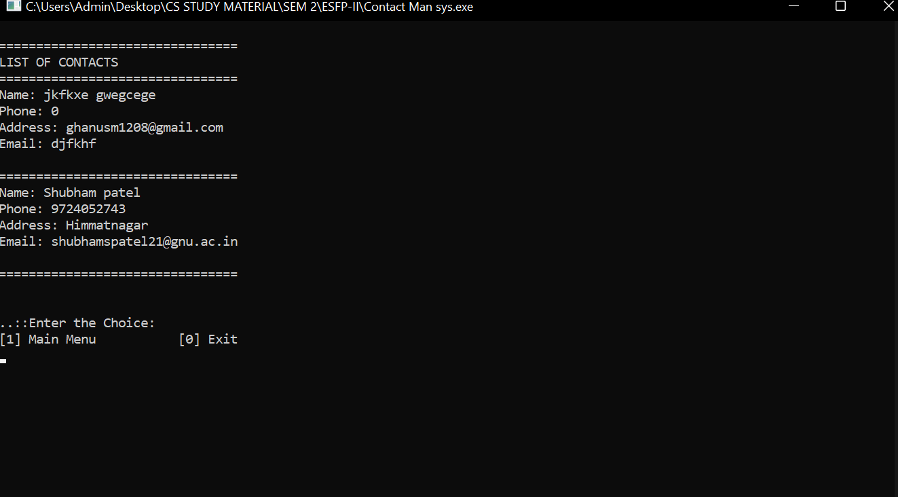
Screenshots
___________________________________________________________________________________________________________
___________________________________________________________________________________________________________

Slide 12
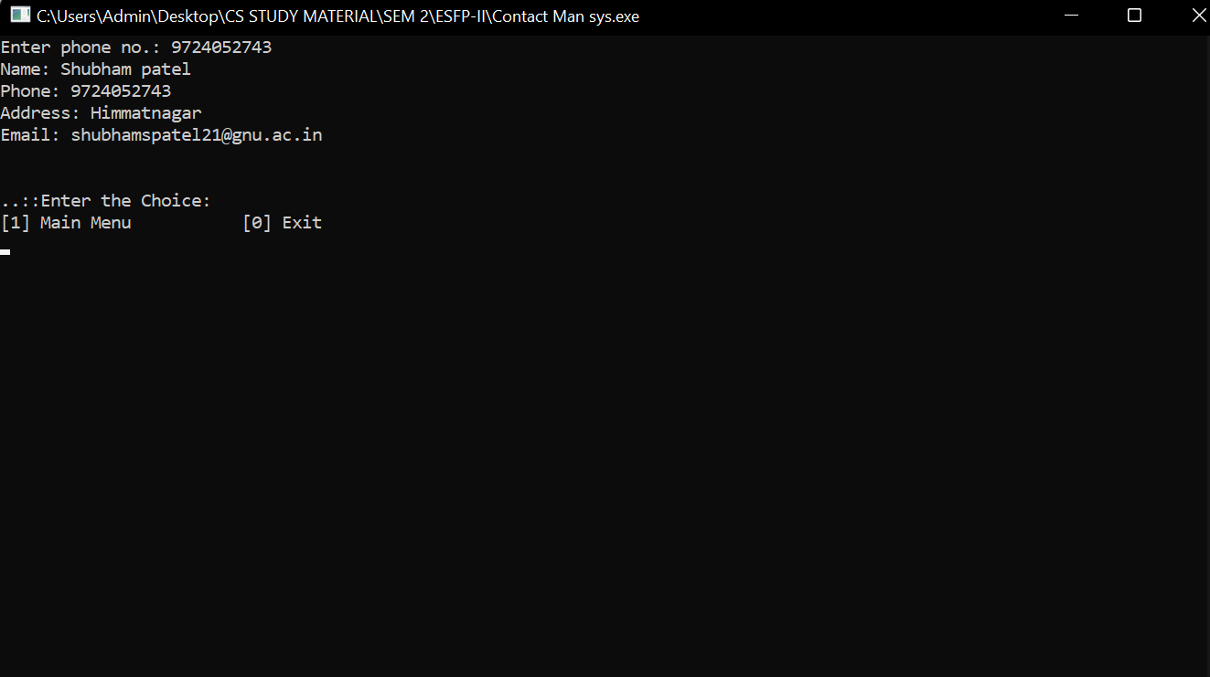
Screenshots
___________________________________________________________________________________________________________
___________________________________________________________________________________________________________

Slide 13
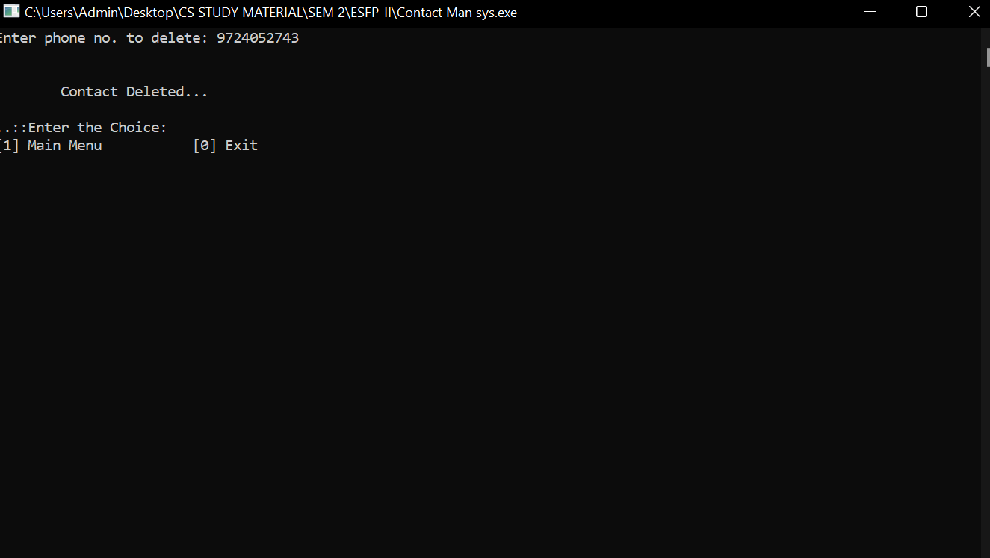
Screenshots
___________________________________________________________________________________________________________
___________________________________________________________________________________________________________

Slide 14
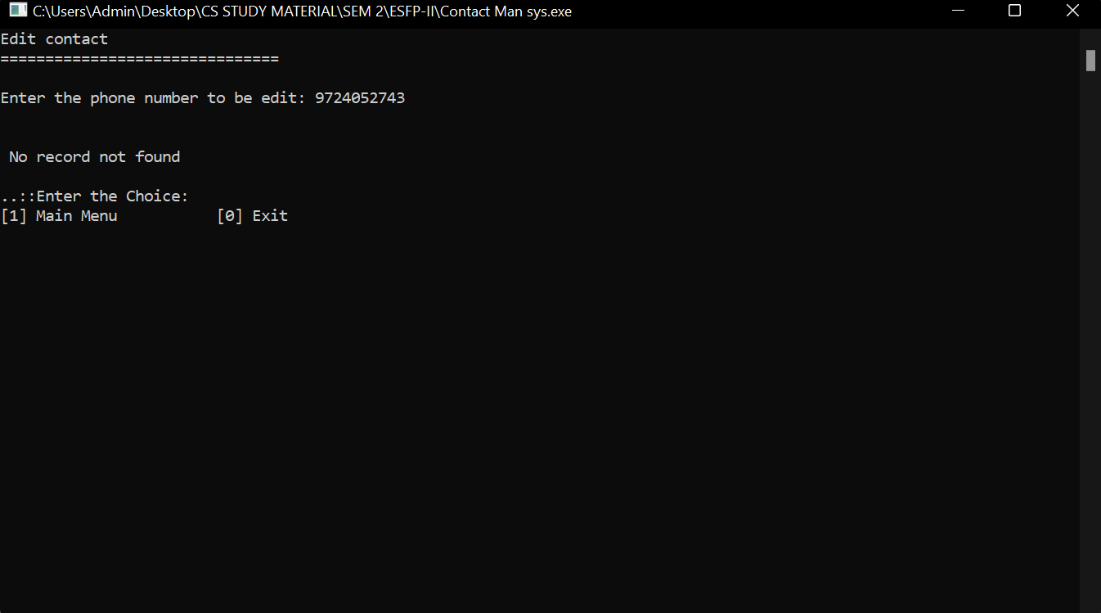
Screenshots
___________________________________________________________________________________________________________
___________________________________________________________________________________________________________

Slide 15
___________________________________________________________________________________________________________
Thank You
___________________________________________________________________________________________________________

